Slide 1
On demand deployment of Uav in wireless communication
EEE 423-Wireless communication
Bsc-ee-2016-01-0092_a.m.m.h.Ranasinghe
Module project

Slide 2
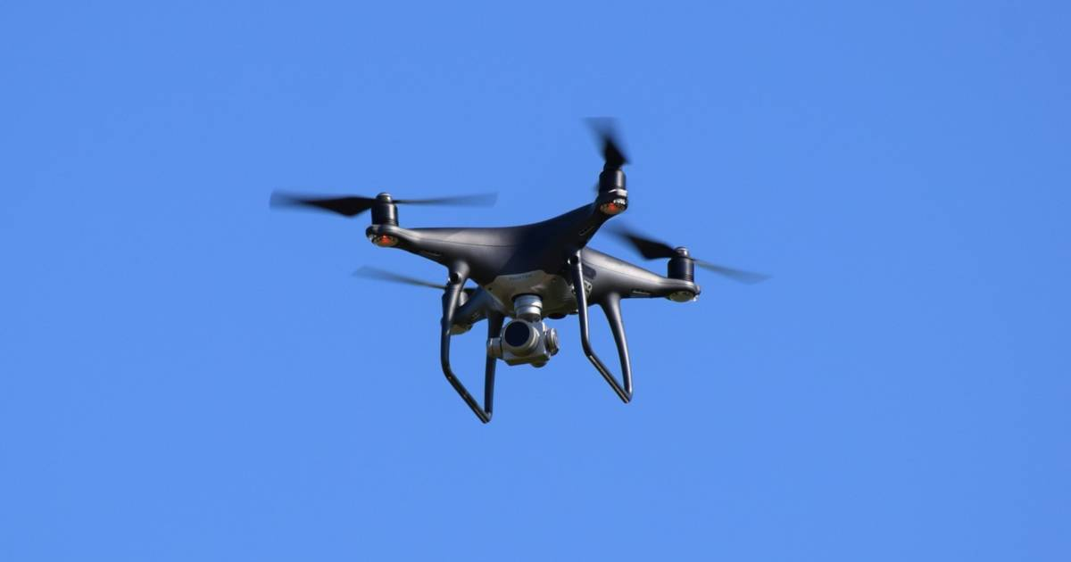
content
Introduction
Current Progress
Future plans
Summary

Slide 3
Introduction
Applications of UAVs
Telecommunication industry
Agriculture
Military services
Weather forecasting
Advantages of UAVs
On demand deployment
Fast response
Cost effective
Fully controllable mobility in 3D
Adjustable altitude

Slide 4
How to use UAV as a Base Station is discussed from this project.

Slide 5
Current Progress
Identified Problems, when positioning UAVs
Positions are changing
Cannot allocate exact bandwidth
Cannot monitor the coverage directions by using directional antenna
The interference is high
So, a solution is found to reduce the interference

Slide 6
Future plans
Simulate the system model
Measure the interference of the system when using the UAVs
Then identify a proper algorithm to reduce the interference.

Slide 7
summary
The UAV deployment of wireless communication is having many problems such as interference, bandwidth allocation etc. So in this presentation, a method is proposed to reduce the interference. Mainly, the progress of the project is discussed.

Slide 8
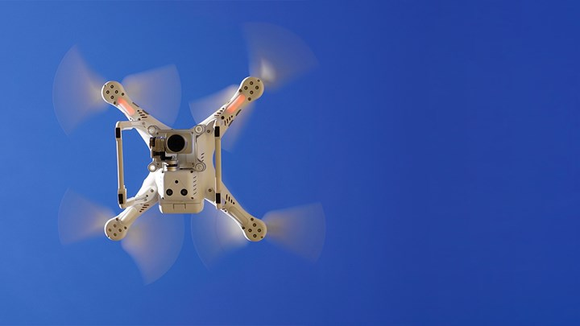
Thank you

